Slide 1
Aline Cristina de Azevedo Silva

Slide 2
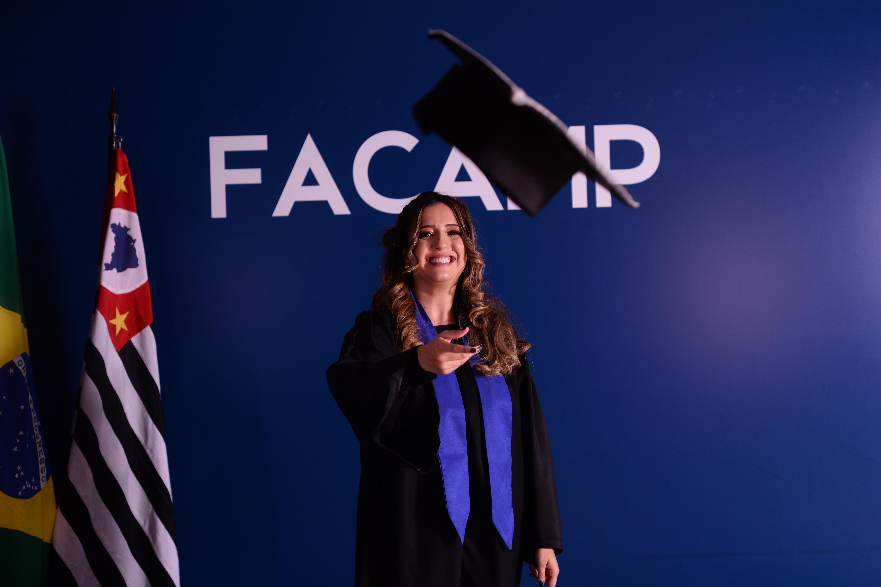
WHO AM I?
I’m 25 years old.
I’m born and raised in São José dos Campos
I have a degree in production engineering.

Slide 3
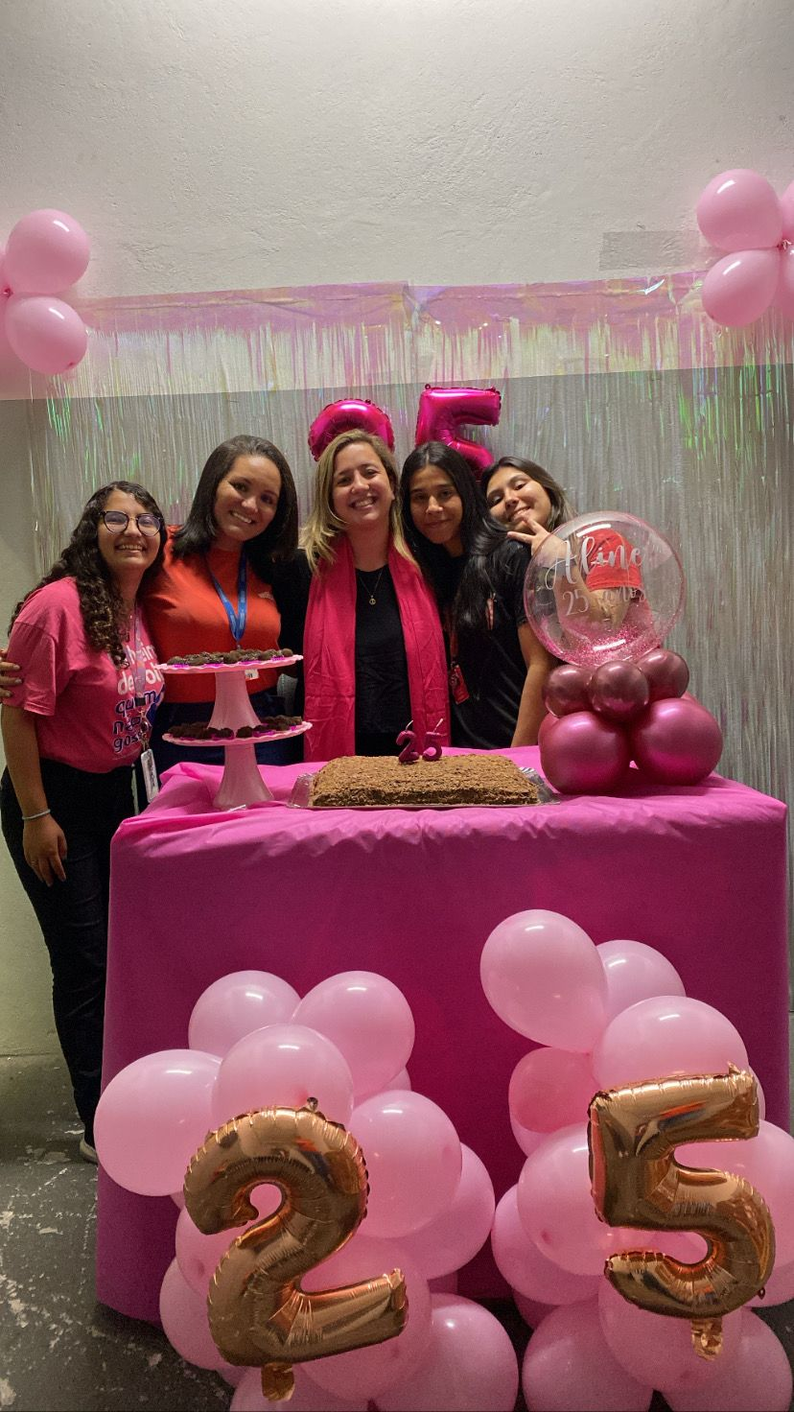

work
I am the general manager of the Americanas store

Slide 4
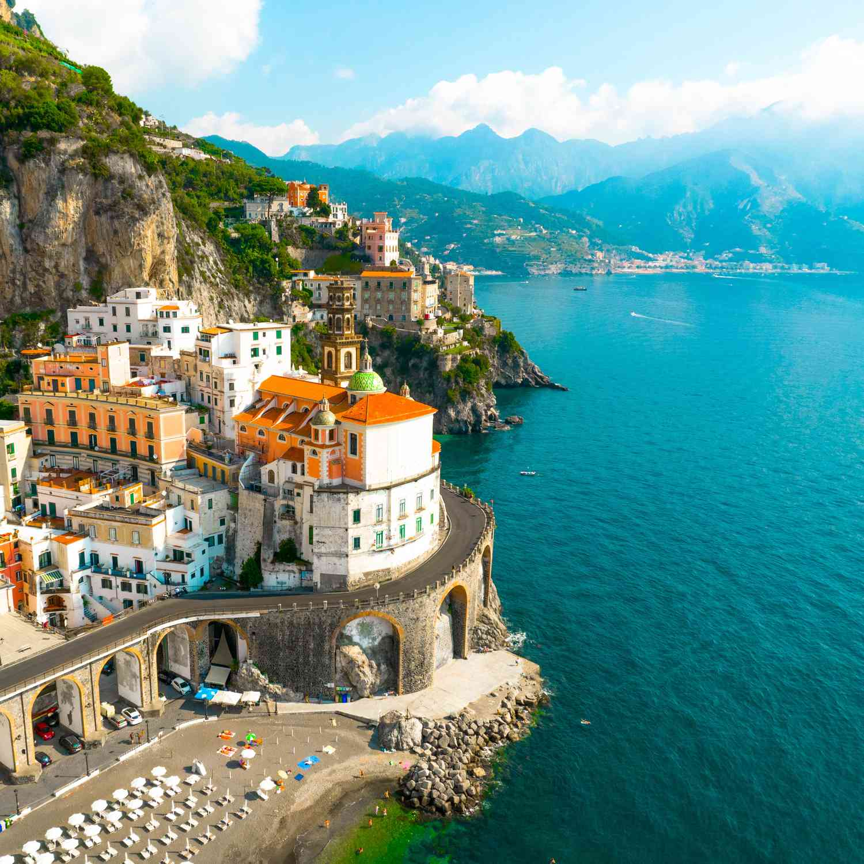

DREAMS
Travel around the world
Get a good job

Slide 5

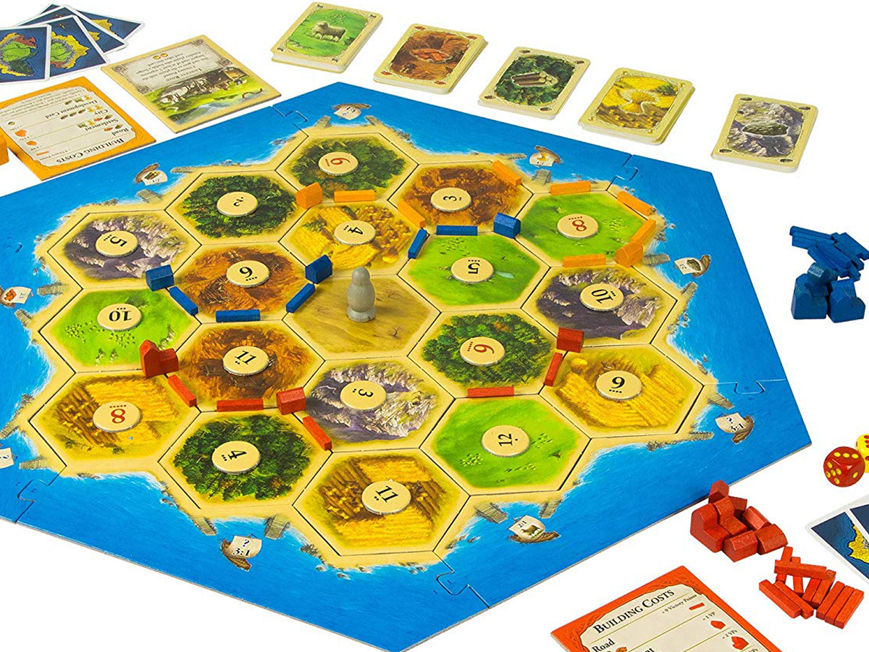

HOBBIES
Watch series
Play board games
Read a books

